Slide 1
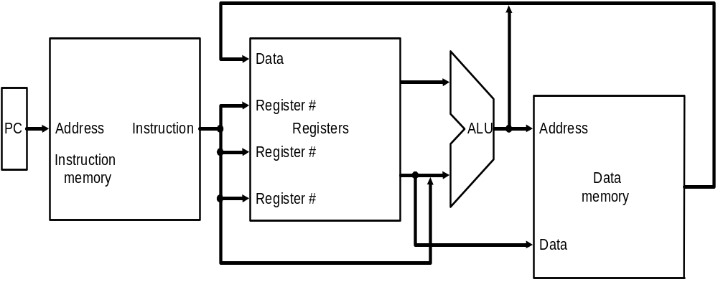
Implementing MIPS: the Fetch/Execute Cycle
High-level abstract view of fetch/execute implementation
  use the program counter (PC) to read instruction address
  fetch the instruction from memory and increment PC
  use fields of the instruction to select registers to read
  execute depending on the instruction
  repeat…

Slide 2
Single-Cycle Design: disadvantage
Assuming fixed-period clock every instruction data-path uses one clock cycle implies:
  CPI = 1
  cycle time determined by length of the longest instruction path (load)
    but several instructions could run in a shorter clock cycle: waste of time
  resources used more than once in the same cycle need to be duplicated
    waste of hardware and chip area

Slide 3
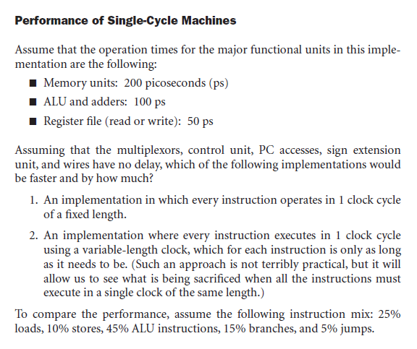

Slide 4
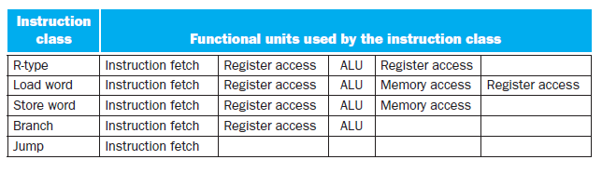
Critical path for different instruction classes

Slide 5
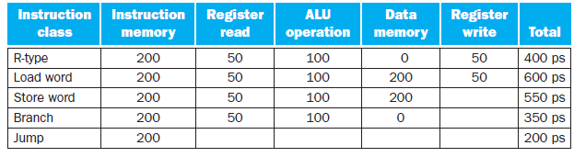
The required length for each instruction

Slide 6
Fixing the problem with single-cycle designs
One solution: a variable-period clock with different cycle times for each instruction class
  unfeasible, as implementing a variable-speed clock is technically difficult
Another solution:
  use a smaller cycle time…
  …have different instructions take different numbers of cycles
  by breaking instructions into steps and fitting each step into one cycle
  feasible: multicyle approach!

Slide 7
Multi cycle implementation
An implementation in which an instruction is executed in multiple clock cycle
Break up the instructions into steps
  each step takes one clock cycle
  It allows a functional unit to be used more than once per instruction, since it is used on different clock
  This Sharing can reduce amount of hardware required

Slide 8
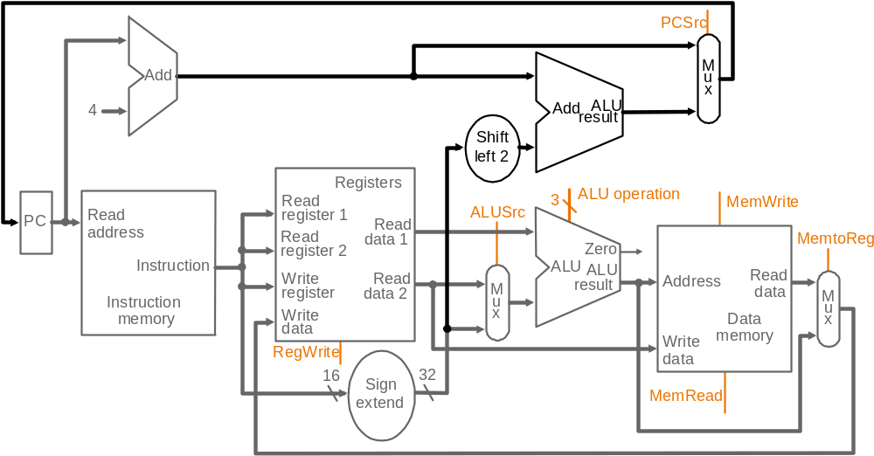
Single-cycle datapath

Slide 9
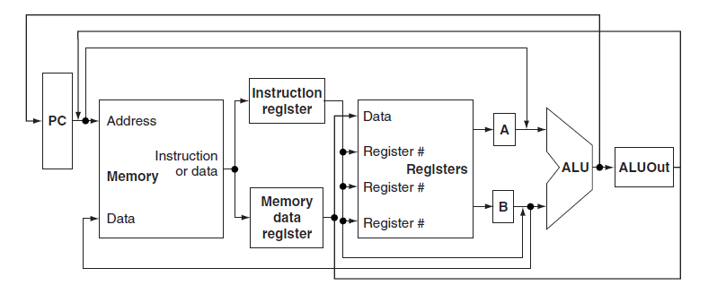

Multi-cycle : abstract implementation

Slide 10
Multicycle Vs single cycle
Note particularities of multicyle vs. single-cycle diagrams
  single memory for data & instructions
  single ALU, no extra adders
  extra registers to hold data between
  clock cycles
Data used by same instruction in a later cycle must be stored into additional registers

Slide 11
Internal registers
Between steps/cycles
  At the end of one cycle store data to be used in later cycles of the same instruction
    need to introduce additional internal (programmer-invisible) registers for this purpose
Temporary registers are
  Instruction Registers (IR), Memory Data Register (MDR) to save output of memory
  Registers A, B to hold register operands
  ALUout register holds the output of ALU

Slide 12
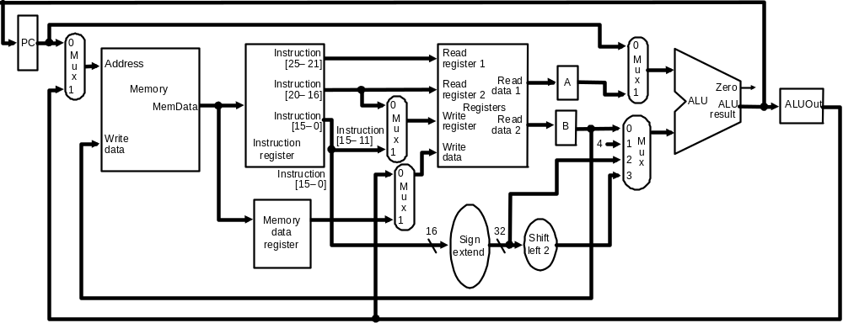
Multicycle Datapath
Basic multicycle MIPS datapath handles R-type instructions and load/stores:
new internal register in red ovals, new multiplexors in blue ovals

Slide 13
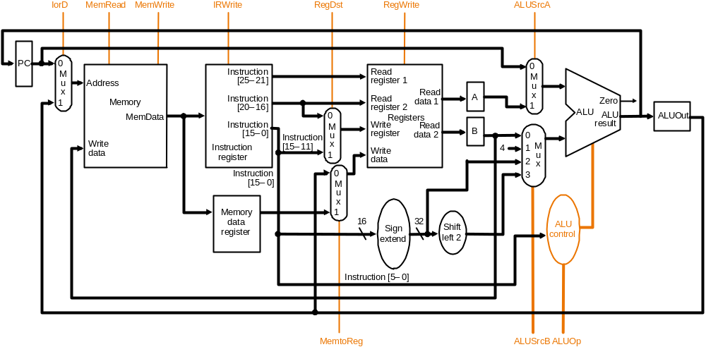
Multicycle Datapath with Control I
… with control lines and the ALU control block added – not all control lines are shown

Slide 14
Multi-cycle design:Advantages
The ability to allow instructions to take different numbers of clock cycles
The ability to share functional units with in the execution of a single instruction

Slide 15
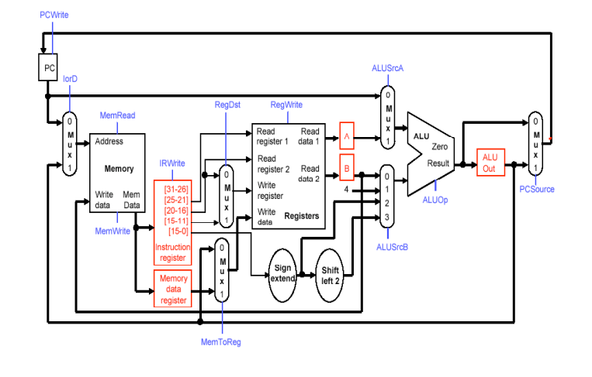
Multi cycle data path with control signals.

Slide 16
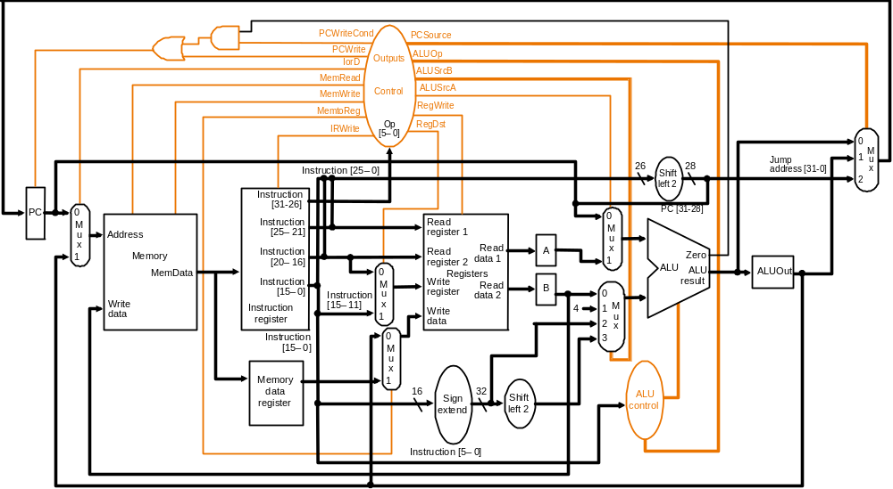
Multicycle Datapath with Control II
New gates
For the jump address
New multiplexor
Complete multicycle MIPS datapath (with branch and jump capability)
and showing the main control block and all control lines

Slide 17
Breaking instructions into steps
Our goal is to break up the instructions into steps so that
  each step takes one clock cycle
  each cycle uses at most once each major functional unit so that such units do not have to be replicated
  functional units can be shared between different cycles within one instruction
Data at end of one cycle to be used in next must be stored !!

Slide 18
Multi-cycle implementation attempt to keep the amount of work per cycle roughly equal.
  Restrict each step to contain at most
    One ALU operation
    One register file access
    One memory access
With this restriction clock cycle could be as short as the longest of these operations.

Slide 19
Breaking instructions into steps
We break instructions into the following potential execution steps ;each step takes one clock cycle
  Instruction fetch and PC increment (IF)
  Instruction decode and register fetch (ID)
  Execution, memory address computation, or branch completion (EX)
  Memory access or R-type instruction completion (MEM)
  Writing data back to register file(WB)
Each MIPS instruction takes from 3 – 5 cycles (steps)

Slide 20
Multicycle Datapath
Basic multicycle MIPS datapath handles R-type instructions and load/stores:
new internal register in red ovals, new multiplexors in blue ovals

Slide 21
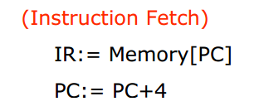
Step 1: Instruction Fetch & PC Increment (IF)
Use PC to get instruction and put it in the instruction register.
Increment the PC by 4 and put the result back in the PC.

Slide 22
Step 2: Instruction Decode and Register Fetch (ID)
Read registers rs and rt in case we need them.
Compute the branch address in case the instruction is a branch.
A = Reg[IR[25-21]];
B = Reg[IR[20-16]];
ALUOut = PC + (sign-extend(IR[15-0]) << 2);

Slide 23
Step 3: Execution, Address Computation or Branch Completion (EX)
ALU performs one of four functions depending on instruction type
  memory reference:
  ALUOut = A + sign-extend(IR[15-0]);
  R-type:
  ALUOut = A op B;
  branch (instruction completes):
  if (A==B) PC = ALUOut;
  jump (instruction completes):
  PC = PC[31-28] || (IR(25-0) << 2)

Slide 24
Step 4: Memory access or R-type Instruction Completion
(MEM)
Again depending on instruction type:
Loads and stores access memory
  load
  MDR = Memory[ALUOut];
  store (instruction completes)
  Memory[ALUOut] = B;
R-type (instructions completes)
Reg[IR[15-11]] = ALUOut;

Slide 25
Step 5: Memory Read Completion (WB)
Again depending on instruction type:
Load writes back (instruction completes)
Reg[IR[20-16]]= MDR;
Important: There is no reason from a datapath (or control) point of view that Step 5 cannot be eliminated by performing
Reg[IR[20-16]]= Memory[ALUOut]; for loads in Step 4. This would eliminate the MDR as well.
The reason this is not done is that, to keep steps balanced in length, the design restriction is to allow each step to contain at most one ALU operation, or one register access, or one memory access.

Slide 26
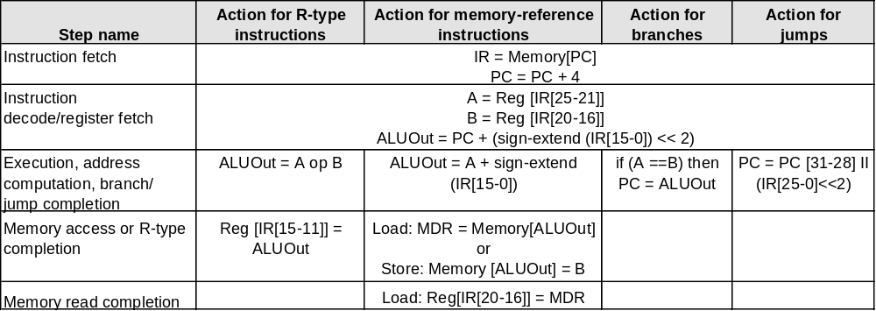
Summary of Instruction Execution
Step
1: IF
2: ID
3: EX
4: MEM
5: WB

Slide 27
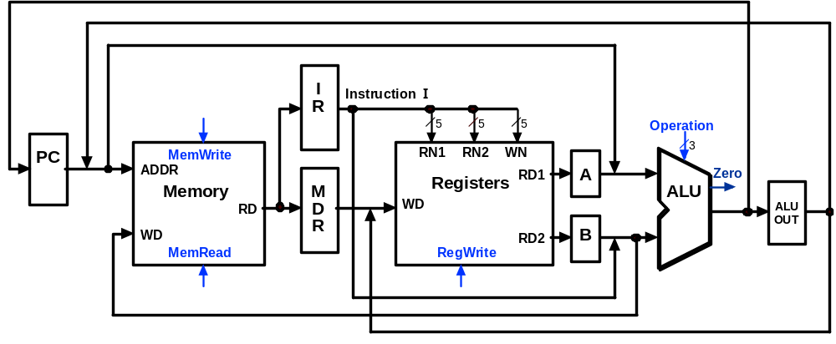
Multicycle Execution Step (1):
Instruction Fetch
IR = Memory[PC];
PC = PC + 4;
4
PC + 4

Slide 28
Multicycle Execution Step (2):
Instruction Decode & Register Fetch
A = Reg[IR[25-21]]; (A = Reg[rs])
B = Reg[IR[20-15]]; (B = Reg[rt])
ALUOut = (PC + sign-extend(IR[15-0]) << 2)
Reg[rs]
Branch
Target
Address
PC + 4
Reg[rt]

Slide 29
Multicycle Execution Step (3):
Memory Reference Instructions
ALUOut = A + sign-extend(IR[15-0]);
Reg[rs]
Mem.
Address
PC + 4
Reg[rt]

Slide 30
Multicycle Execution Step (3):
ALU Instruction (R-Type)
ALUOut = A op B
Reg[rs]
R-Type
Result
PC + 4
Reg[rt]

Slide 31
Multicycle Execution Step (3):
Branch Instructions
if (A == B) PC = ALUOut;
Reg[rs]
Branch
Target
Address
Branch
Target
Address
Reg[rt]

Slide 32
Multicycle Execution Step (3):
Jump Instruction
PC = PC[31-28] concat (IR[25-0] << 2)
Reg[rs]
Branch
Target
Address
Jump
Address
Reg[rt]

Slide 33
Multicycle Execution Step (4):
Memory Access - Read (lw)
MDR = Memory[ALUOut];
Reg[rs]
Mem.
Address
PC + 4
Mem.
Data
Reg[rt]

Slide 34
Multicycle Execution Step (4):
Memory Access - Write (sw)
Memory[ALUOut] = B;
Reg[rs]
PC + 4
Reg[rt]

Slide 35
Multicycle Execution Step (4):
ALU Instruction (R-Type)
Reg[IR[15:11]] = ALUOUT
Reg[rs]
R-Type
Result
PC + 4
Reg[rt]

Slide 36
Multicycle Execution Step (5):
Memory Read Completion (lw)
Reg[IR[20-16]] = MDR;
Reg[rs]
Mem.
Address
PC + 4
Mem.
Data
Reg[rt]

Slide 37
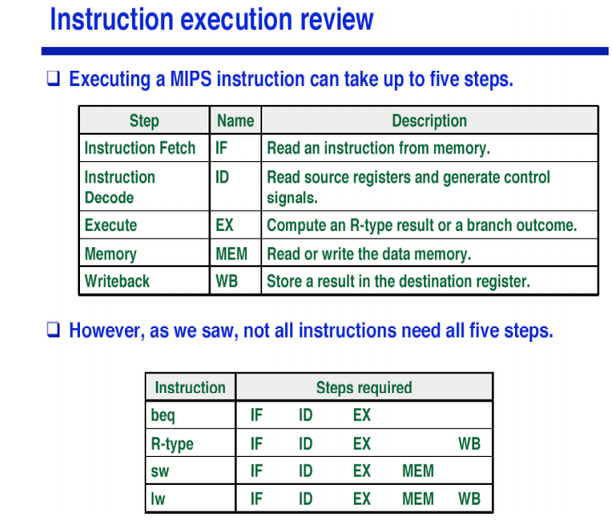

Slide 38
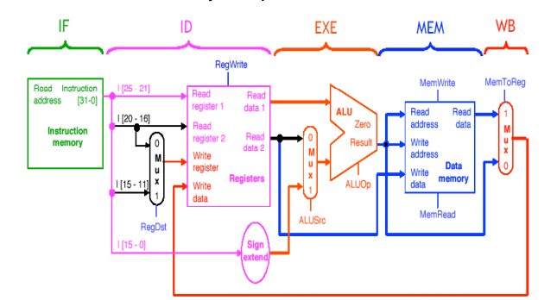
Break data path into 5 stages

